Slide 1
Memory Hierarchy (Ⅱ)

Slide 2
Outline
Storage technologies and trends
Locality
The memory hierarchy
Cache memories
Suggested Reading: 6.1, 6.2, 6.3, 6.4

Slide 3
Storage technologies and trends
Locality
The memory hierarchy
Cache memories

Slide 4
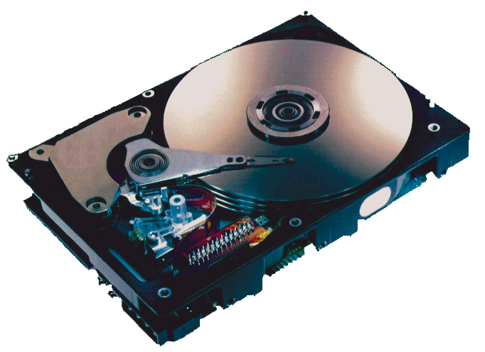
What’s inside a disk drive?
Spindle
Arm
Platters
Actuator
Electronics
(including a
processor
and memory!)
SCSI
connector
Image courtesy of Seagate Technology

Slide 5
Disk geometry
Disks consist of platters, each with two surfaces.
Each surface consists of concentric rings called tracks.
Each track consists of sectors separated by gaps.
tracks
surface
track k
gaps
spindle
sectors

Slide 6
Disk geometry (muliple-platter view)
Aligned tracks form a cylinder.
cylinder k
surface 0
platter 0
surface 1
surface 2
platter 1
surface 3
surface 4
platter 2
surface 5
spindle

Slide 7
Disk capacity
Capacity
  maximum number of bits that can be stored
  Vendors express capacity in units of gigabytes (GB), where 1 GB = 10^9.
Capacity is determined by these technology factors:
  Recording density (bits/in): number of bits that can be squeezed into a 1 inch segment of a track.
  Track density (tracks/in): number of tracks that can be squeezed into a 1 inch radial segment.
  Areal density (bits/in²): product of recording and track density.

Slide 8
Disk capacity
Old fashioned disks
  Each track has the same number of sectors
Modern disks partition tracks into disjoint subsets called recording zones
  Each track in a zone has the same number of sectors, determined by the circumference of innermost track
  Each zone has a different number of sectors/track

Slide 9
Computing disk capacity
Capacity = (# bytes/sector)
x (avg. # sectors/track)
x (# tracks/surface)
x (# surfaces/platter)
x (# platters/disk)
Example:
  512 bytes/sector
  300 sectors/track (on average)
  20,000 tracks/surface
  2 surfaces/platter
  5 platters/disk
Capacity = 512 x 300 x 20000 x 2 x 5
= 30,720,000,000
= 30.72 GB

Slide 10
Disk operation (single-platter view)
The disk surface
spins at
a fixed
rotational
rate
The read/write head
is attached to the end of
the arm and flies over
the disk surface on
a thin cushion of air.
spindle
By moving radially,
the arm can position the read/write head over any track.

Slide 11
Disk operation (multi-platter view)
read/write heads
move in unison
from cylinder to cylinder
arm
spindle

Slide 12
Disk Structure - top view of single platter
Surface organized into tracks
Tracks divided into sectors
Notes:
Goal:
Show the inefficeincy of current disk requests.
Conveyed Ideas:
Rotational latency is wasted time that can be used to service tasks
Background Information:
None.
Slide Background:
None.
Kill text and arrows

Slide 13
Disk Access
Head in position above a track
Notes:
Goal:
Show the inefficeincy of current disk requests.
Conveyed Ideas:
Rotational latency is wasted time that can be used to service tasks
Background Information:
None.
Slide Background:
None.
Kill text and arrows

Slide 14
Disk Access
Rotation is counter-clockwise
Notes:
Goal:
Show the inefficeincy of current disk requests.
Conveyed Ideas:
Rotational latency is wasted time that can be used to service tasks
Background Information:
None.
Slide Background:
None.
Kill text and arrows

Slide 15
Disk Access – Read
About to read blue sector
Notes:
Goal:
Show the inefficeincy of current disk requests.
Conveyed Ideas:
Rotational latency is wasted time that can be used to service tasks
Background Information:
None.
Slide Background:
None.
Kill text and arrows

Slide 16
Disk Access – Read
After BLUE read
After reading blue sector
Notes:
Goal:
Show the inefficeincy of current disk requests.
Conveyed Ideas:
Rotational latency is wasted time that can be used to service tasks
Background Information:
None.
Slide Background:
None.
Kill text and arrows

Slide 17
Disk Access – Read
After BLUE read
Red request scheduled next
Notes:
Goal:
Show the inefficeincy of current disk requests.
Conveyed Ideas:
Rotational latency is wasted time that can be used to service tasks
Background Information:
None.
Slide Background:
None.
Kill text and arrows

Slide 18
Disk Access – Seek
After BLUE read
Seek for RED
Seek to red’s track
Notes:
Goal:
Show the inefficeincy of current disk requests.
Conveyed Ideas:
Rotational latency is wasted time that can be used to service tasks
Background Information:
None.
Slide Background:
None.
Kill text and arrows

Slide 19
Disk Access – Rotational Latency
After BLUE read
Seek for RED
Rotational latency
Wait for red sector to rotate around
Notes:
Goal:
Show the inefficeincy of current disk requests.
Conveyed Ideas:
Rotational latency is wasted time that can be used to service tasks
Background Information:
None.
Slide Background:
None.
Kill text and arrows

Slide 20
Disk Access – Read
After BLUE read
Seek for RED
Rotational latency
After RED read
Complete read of red
Notes:
Goal:
Show the inefficeincy of current disk requests.
Conveyed Ideas:
Rotational latency is wasted time that can be used to service tasks
Background Information:
None.
Slide Background:
None.
Kill text and arrows

Slide 21
Disk Access – Service Time Components
After BLUE read
Seek for RED
Rotational latency
After RED read
Data transfer
Seek
Rotational
latency
Data transfer
Notes:
Goal:
Show the inefficeincy of current disk requests.
Conveyed Ideas:
Rotational latency is wasted time that can be used to service tasks
Background Information:
None.
Slide Background:
None.
Kill text and arrows

Slide 22
Disk access time
Average time to access some target sector approximated by
  T_{access} = T_{avg} _{seek} + T_{avg} _{rotation} + T_{avg} _{transfer}
Seek time
  Time to position heads over cylinder containing target sector.
  Typical T_{avg} _{seek} = 9 ms

Slide 23
Disk access time
Rotational latency
  Time waiting for first bit of target sector to pass under r/w head.
  T_{avg} _{rotation} = 1/2 x 1/RPMs x 60 sec/1 min
Transfer time
  Time to read the bits in the target sector.
  T_{avg transfer} = 1/(avg # sectors/track) x 1/RPM x 60 secs/1 min.

Slide 24
Disk access time example
Example:
  Rotational rate 7,200 RPM
  T_{avg} _{seek} 9 ms
  Avg # sectors/track 400
  T_{avg} _{rotation} = 1/2 x (60secs/7200RPM) x 1000ms/sec
  = 4ms
  T_{avg transfer} = 1/400secs/track x 60sec/7200RPM
  x 1000ms/sec
  = 0.02 ms
  T_{access} = 9 ms + 4 ms + 0.02 ms

Slide 25
Disk access time example
Important points
  Access time dominated by seek time and rotational latency
  First bit in a sector is the most expensive, the rest are free
  SRAM access time is about 4 ns/double word
  DRAM is about 60 ns
  Disk is about 40,000 times slower than SRAM
  Disk is about 2,500 times slower then DRAM

Slide 26
Logical disk blocks
Modern disks present a simpler abstract view of the complex sector geometry:
  The set of available sectors is modeled as a sequence of
  b-sized logical blocks (0, 1, 2, ...)
Mapping between logical blocks and actual (physical) sectors
  Maintained by hardware/firmware device called
  disk controller
  Converts requests for logical blocks into
  (surface, track, sector) triples.

Slide 27
Formatted disk capacity
Allows controller to set aside spare cylinders for each zone
  Accounts for the difference in “formatted capacity” and “maximum capacity”

Slide 28
Peripheral Component Interconnect
(PCI)
CPU chip
register file
ALU
system bus
memory bus
I/O
bridge
main
memory
bus interface
I/O bus
Expansion slots for
other devices such
as network adapters
USB
controller
graphics
adapter
Host Bus
Adaptor
SCSI/SATA
mouse
keyboard
monitor
solid stat disk
disk
controller
Disk drive
disk

Slide 29
Memory-mapped I/O
I/O Port
  A reserved address in the address space
  for the CPU to communicate with an I/O device
Each device is associated with (or mapped to)
  One or more ports when it is attached to the bus

Slide 30
Reading a disk sector (2)
CPU chip
1. CPU initiates a disk read by writing a command, logical block number, and destination memory address to a port (address) associated with disk controller
register file
ALU
main
memory
bus interface
I/O bus
USB
controller
graphics
adapter
disk
controller
mouse
keyboard
monitor
disk

Slide 31
Reading a disk sector
CPU chip
2. Disk controller reads the sector and performs a DMA (direct memory access) transfer into main memory
register file
ALU
main
memory
bus interface
I/O bus
USB
controller
graphics
adapter
disk
controller
mouse
keyboard
monitor
disk

Slide 32
DMA
Direct memory access
A device performs a read or write bus transaction on its own, without any involvement of the CPU
The transfer of data is known as a DMA transfer

Slide 33
Reading a disk sector
CPU chip
3. When the DMA transfer completes, the disk controller notifies the CPU with an interrupt (i.e., asserts a special “interrupt” pin on the CPU)
register file
ALU
Interrupt
main
memory
bus interface
I/O bus
USB
controller
graphics
adapter
disk
controller
mouse
keyboard
monitor
disk

Slide 34
Interrupt
I/O devices trigger interrupts by signaling a pin on the processor chip
  network adapters, disk controllers, timer chips
I/O devices place a number onto the system bus
  identifies the device that caused the interrupt
Cause the CPU stop what it is currently working on, and jump to an operating system routine

Slide 35
Solid State Disk (SSD)
Solid state disk (SSD) is a storage technology, based on flash memory
  SSD package plugs into a standard disk slot on the I/O bus (typically USB or SATA)
  Flash translation layer = disk controller

Slide 36
Solid State Disk (SSD)
I/O bus
Requests to read and write logical disk blocks
Solid State Disk (SSD)
Flash
translation layer
Flash memory
Block 0
Block B-1
…
…
…
Page 0
Page 1
Page P-1
Page 0
Page 1
Page P-1
Pages: 512KB to 4KB, Blocks: 32 to 128 pages
Data read/written in units of pages.
Page can be written only after its block has been erased
A block wears out after 100,000 repeated writes.

Slide 37
SSD Performance Characteristics
Sequential read tput 250 MB/s Sequential write tput 170 MB/s
Random read tput 140 MB/s Random write tput 14 MB/s
Random read access 30 us Random write access 300 us
Why are random writes so slow?
  Erasing a block is slow (around 1 ms)
  Write to a page triggers a copy of all useful pages in the block
    Find an used block (new block) and erase it
    Write the page into the new block
    Copy other pages from old block to the new block

Slide 38
SSD Tradeoffs vs Rotating Disks
Advantages
  No moving parts → faster, less power, more rugged
Disadvantages
  Have the potential to wear out
    Mitigated by “wear leveling logic” in flash translation layer
    e.g. Intel X25 guarantees 1 petabyte (10^15 bytes) of random writes before they wear out
  In 2010, about 100 times more expensive per byte
Applications
  MP3 players, smart phones, laptops
  Beginning to appear in desktops and servers

Slide 39
Storage Trends
SRAM
Metric 1980 1985 1990 1995 2000 2005 2010 2010:1980
$/MB 19,200 2,900 320 256 100 75 60 320
access (ns) 300 150 35 15 3 2 1.5 200
DRAM
Metric 1980 1985 1990 1995 2000 2005 2010 2010:1980
$/MB 8,000 880 100 30 1 0.1 0.06 130,000
access (ns) 375 200 100 70 60 50 40 9
typical size (MB) 0.064 0.256 4 16 64 2,000 8,000 125,000
Disk
Metric 1980 1985 1990 1995 2000 2005 2010 2010:1980
$/MB 500 100 8 0.30 0.01 0.005 0.0003 1,600,000
access (ms) 87 75 28 10 8 4 3 29
typical size (MB) 1 10 160 1,000 20,000 160,000 1,500,000 1,500,000

Slide 40
CPU Clock Rates
Inflection point in computer history
when designers hit the “Power Wall”
1980 1990 1995 2000 2003 2005 2010 2010:1980
CPU 8080 386 Pentium P-III P-4 Core 2 Core i7 ---
Clock
rate (MHz) 1 20 150 600 3300 2000 2500 2500
Cycle
time (ns) 1000 50 6 1.6 0.3 0.50 0.4 2500
Cores 1 1 1 1 1 2 4 4
Effective
cycle 1000 50 6 1.6 0.3 0.25 0.1 10,000
time (ns)

Slide 41
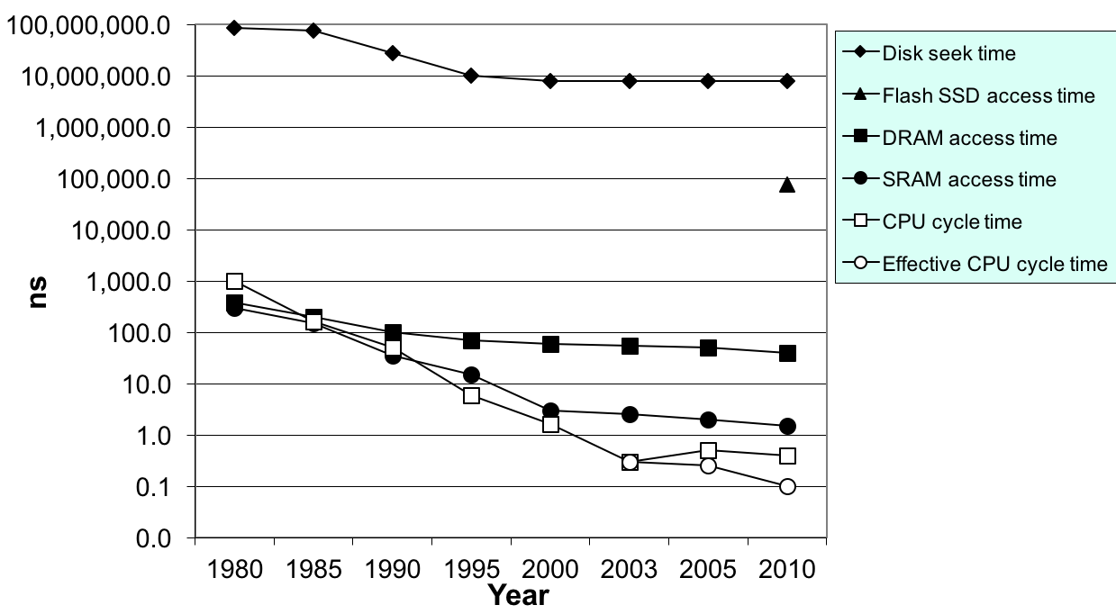
The CPU-Memory Gap
Disk
SSD
DRAM
CPU

Slide 42
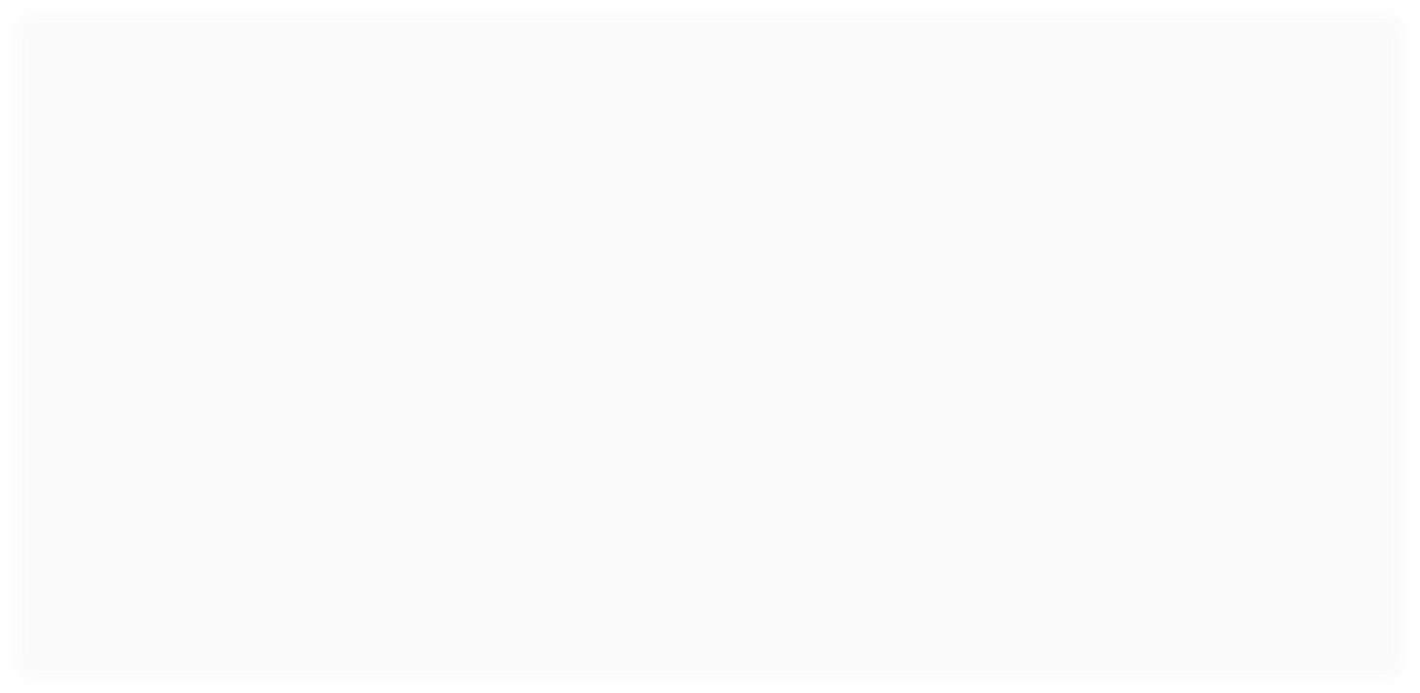
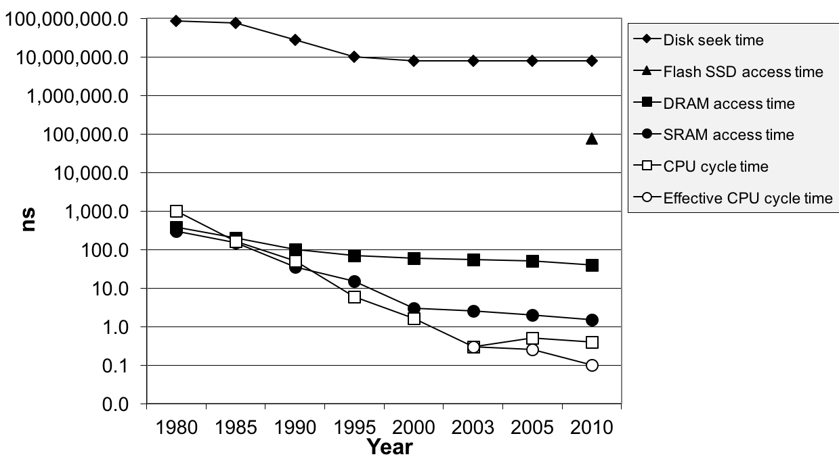
The CPU-Memory Gap
The gap widens between DRAM, disk, and CPU speeds.
Disk
The key to bridging this CPU-Memory gap is
a fundamental property of computer programs
known as locality
SSD
DRAM
CPU

Slide 43
Storage technologies and trends
Locality
The memory hierarchy
Cache memories

Slide 44
Locality
Principle of Locality: Programs tend to use data and instructions with addresses near or equal to those they have used recently
  Temporal locality
    Recently referenced items are likely
    to be referenced again in the near future
  Spatial locality
    Items with nearby addresses tend
    to be referenced close together in time

Slide 45
Locality
All levels of modern computer systems are designed to exploit locality
  Hardware
    Cache memory (to speed up main memory accesses)
  Operating systems
    Use main memory to speed up virtual address space accesses
    Use main memory to speed up disk file accesses
  Application programs
    Web browsers exploit temporal locality by caching recently referenced documents on a local disk

Slide 46
Locality
int sumvec(int v[N])
{
int i, sum = 0 ;
for (i = 0 ; i < N ; i++)
sum += v[i] ;
return sum ;
}
Address | 0 | 4 | 8 | 12 | 16 | 20 | 24 | 28
Contents | v₀ | v₁ | v₂ | v₃ | v₄ | v₅ | v₆ | v₇
Access order | 1 | 2 | 3 | 4 | 5 | 6 | 7 | 8

Slide 47
Locality
Locality in the example
  sum: temporal locality
  v: spatial locality
    Stride-1 reference pattern
Stride-k reference pattern
  Visiting every k-th element of a contiguous vector
  As the stride increases, the spatial locality decreases

Slide 48
Stride-1 reference pattern
int sumarrayrows(int a[M][N])
{
int i, j, sum = 0 ;
for (i = 0 ; i < M ; i++)
for ( j = 0 ; j < N ; j++ )
sum += a[i][j] ;
return sum ;
}
Address | 0 | 4 | 8 | 12 | 16 | 20
Contents | a₀₀ | a₀₁ | a₀₂ | a₁₀ | a₁₁ | a₁₂
Access order | 1 | 2 | 3 | 4 | 5 | 6

Slide 49
Stride-N reference pattern
int sumarraycols(int a[M][N])(M=2,N=3)
{
int i, j, sum = 0 ;
for (j = 0 ; j < N ; j++)
for ( i = 0 ; i < M ; i++ )
sum += a[i][j] ;
return sum ;
}
Address | 0 | 4 | 8 | 12 | 16 | 20
Contents | a₀₀ | a₀₁ | a₀₂ | a₁₀ | a₁₁ | a₁₂
Access order | 1 | 3 | 5 | 2 | 4 | 6

Slide 50
Locality
Locality of the instruction fetch
  Spatial locality
    In most cases, programs are executed in sequential order
  Temporal locality
    Instructions in loops may be executed many times

Slide 51
Locality
sum = 0;
for (i = 0; i < n; i++)
sum += a[i];
return sum;
Data references
  Reference array elements in succession Spatial locality
  Reference variable sum each iteration Temporal locality
Instruction references
  Reference instructions in sequence. Spatial locality
  Cycle through loop repeatedly Temporal locality

